Slide 1
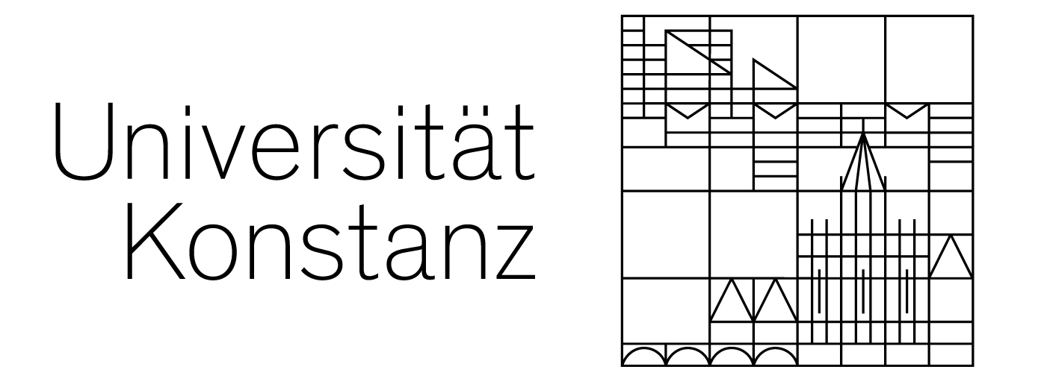

Depth-Aware Coherent Line Drawings
Marc Spicker¹, Julian Kratt¹,
Diana Arellano², Oliver Deussen¹
¹ University of Konstanz, Germany
² Filmakademie Baden-Württemberg, Germany

Slide 2

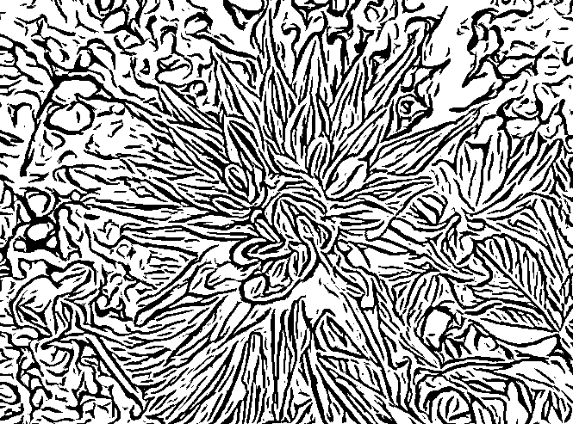
Motivation
Line drawing to depict form and structure
Well suited but sometimes problematic:
Information about spatial arrangement is lost!

Slide 3
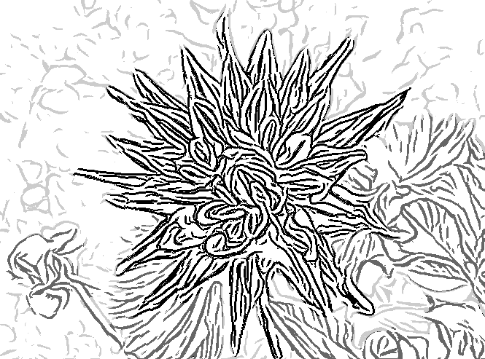
Motivation
Line drawing to depict form and structure
We propose:
Improved depth perception and object differentiation!

Slide 4
Related Work
Image space line drawings:
[Canny 1986]
[Kang et al. 2007]
[Winnemöller et al. 2012]
[Winnemöller et al. 2006]
[Rosin and Lai 2010]

Slide 5
Related Work
Depth information in NPR:
[Saito and Takahashi 1990]
[Tan et al. 2005]
[Everts et al. 2009]
[Deussen and Strothotte 2000]
[Luft et al. 2006]

Slide 6
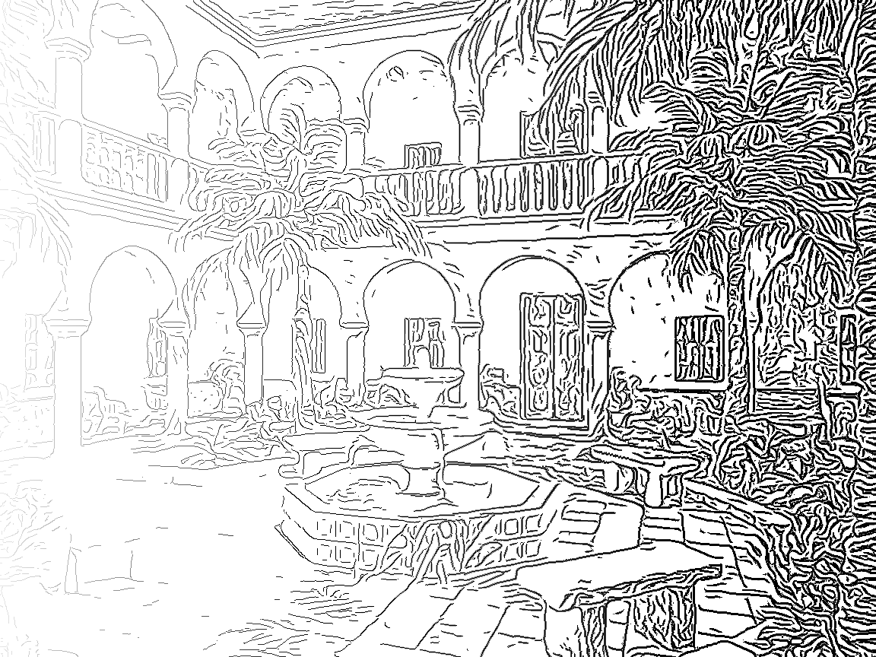
Contributions
More control over line drawings
Line width:
Small
Line width:
Large
Details:
Few
Details:
Many
Focus:
Weak
Focus:
Strong

Slide 7
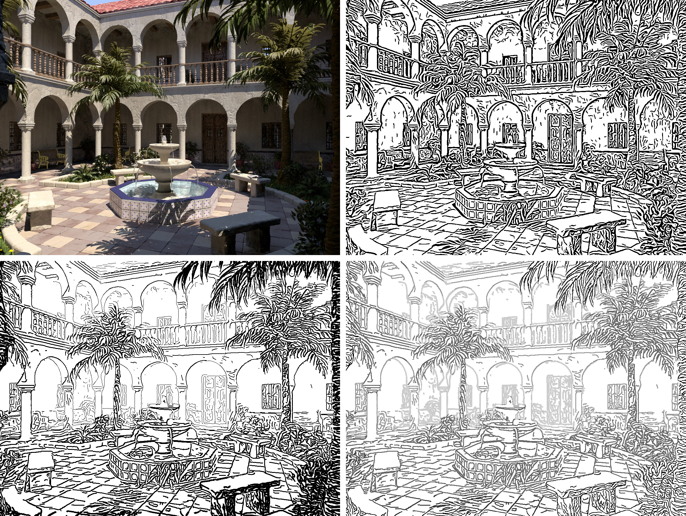
Our Method
Input
[Kang et al. 2007]
Ours (Style 1)
Ours (Style 2)

Slide 8
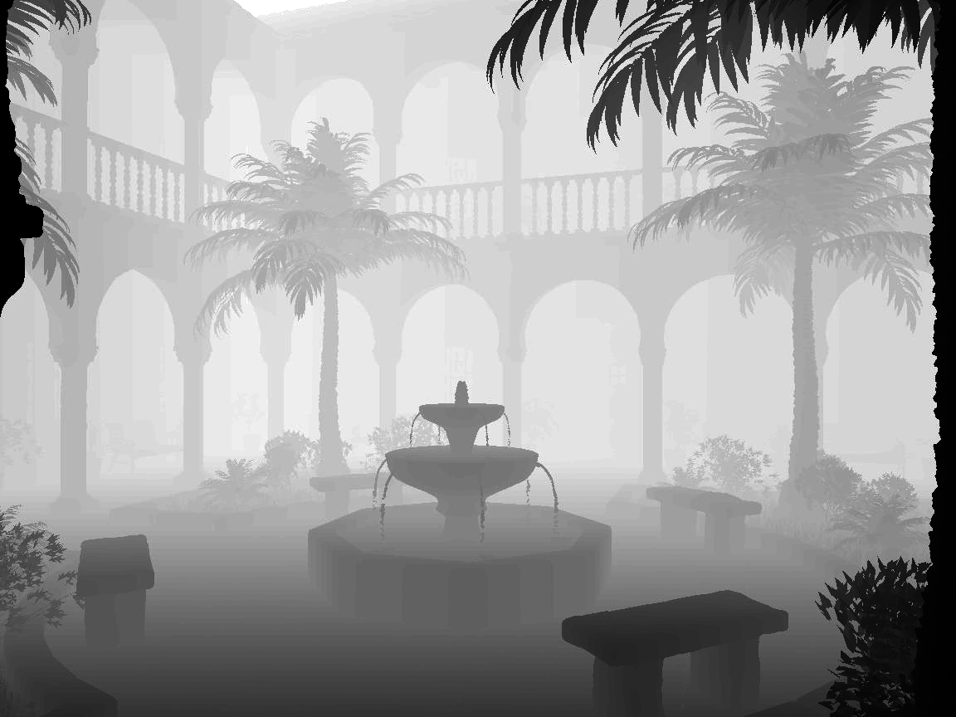
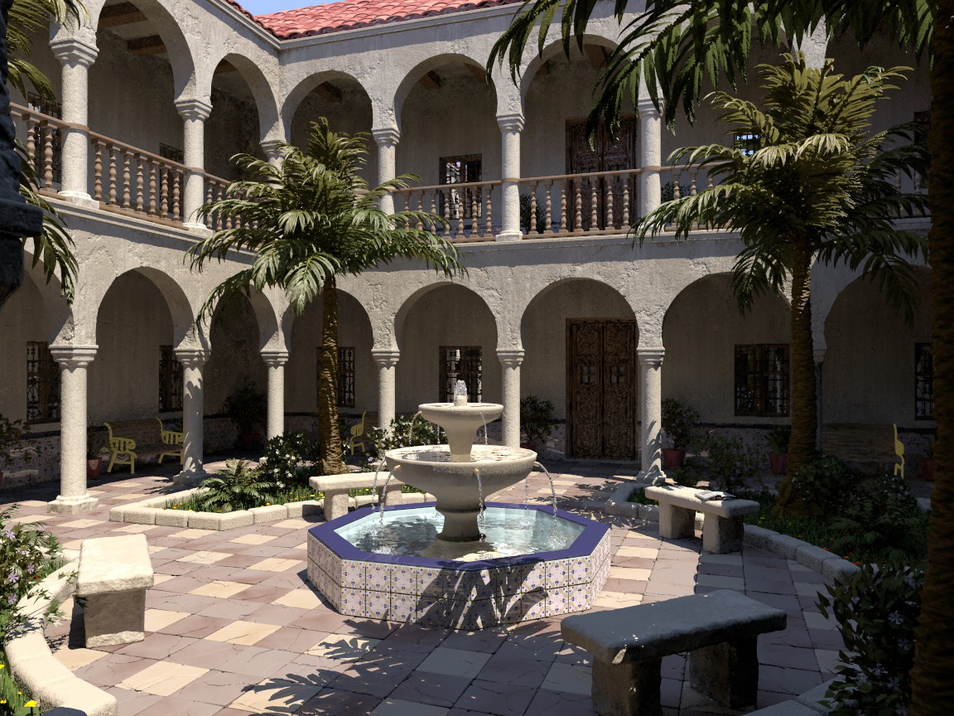
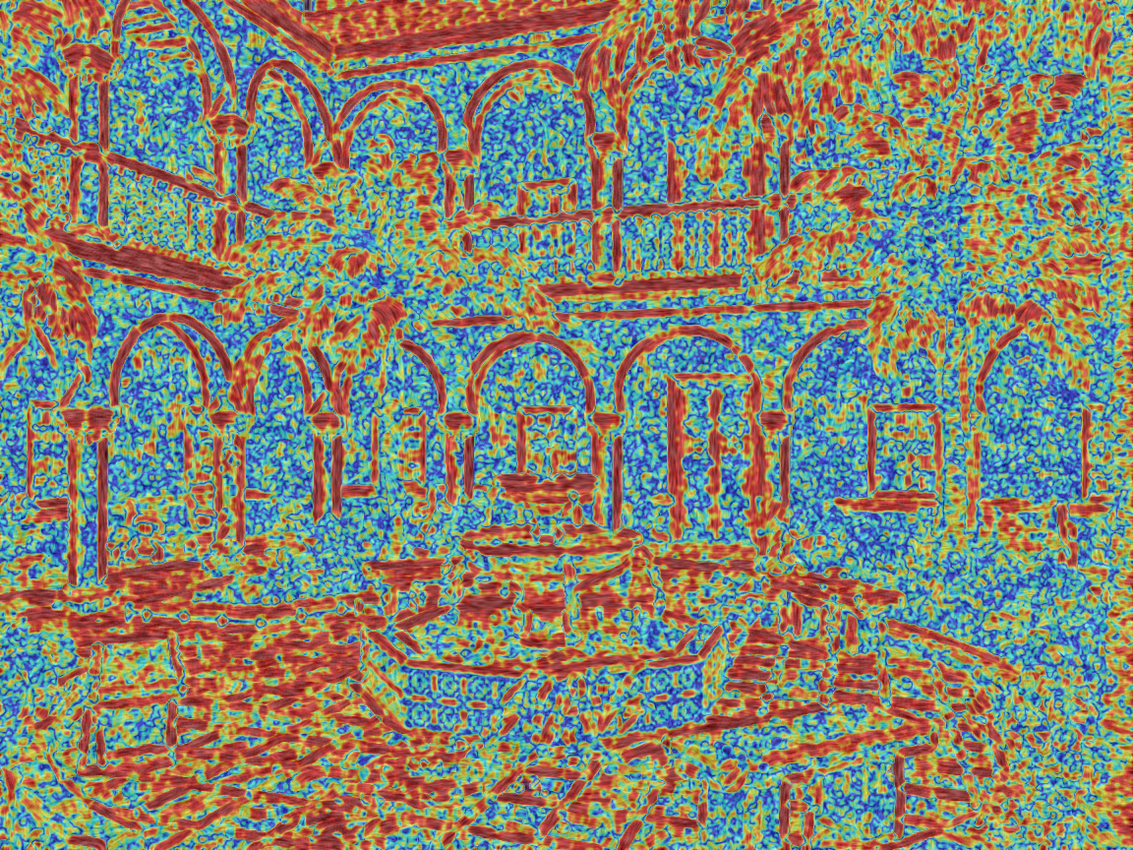
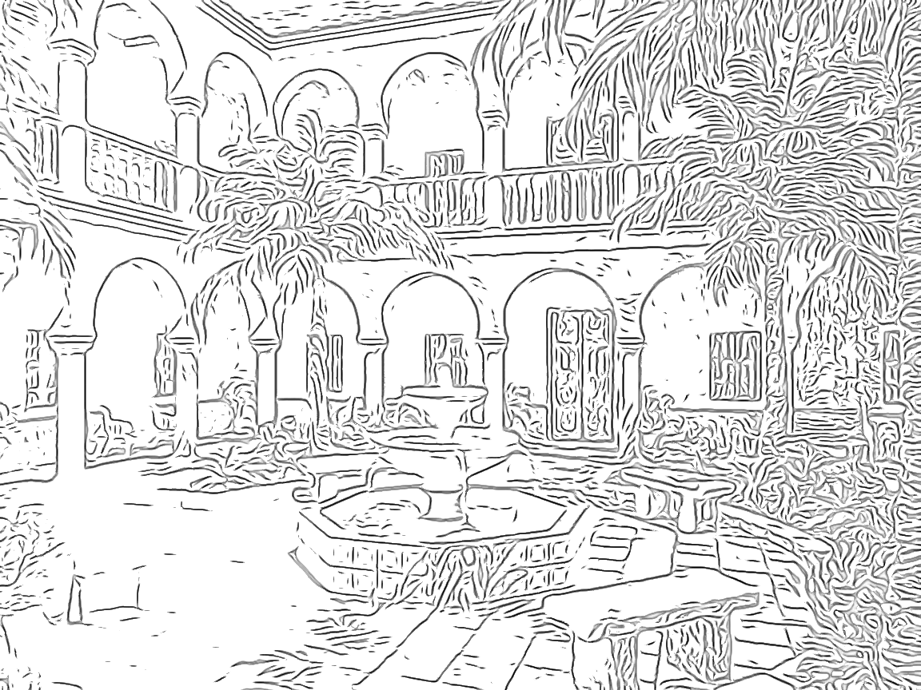
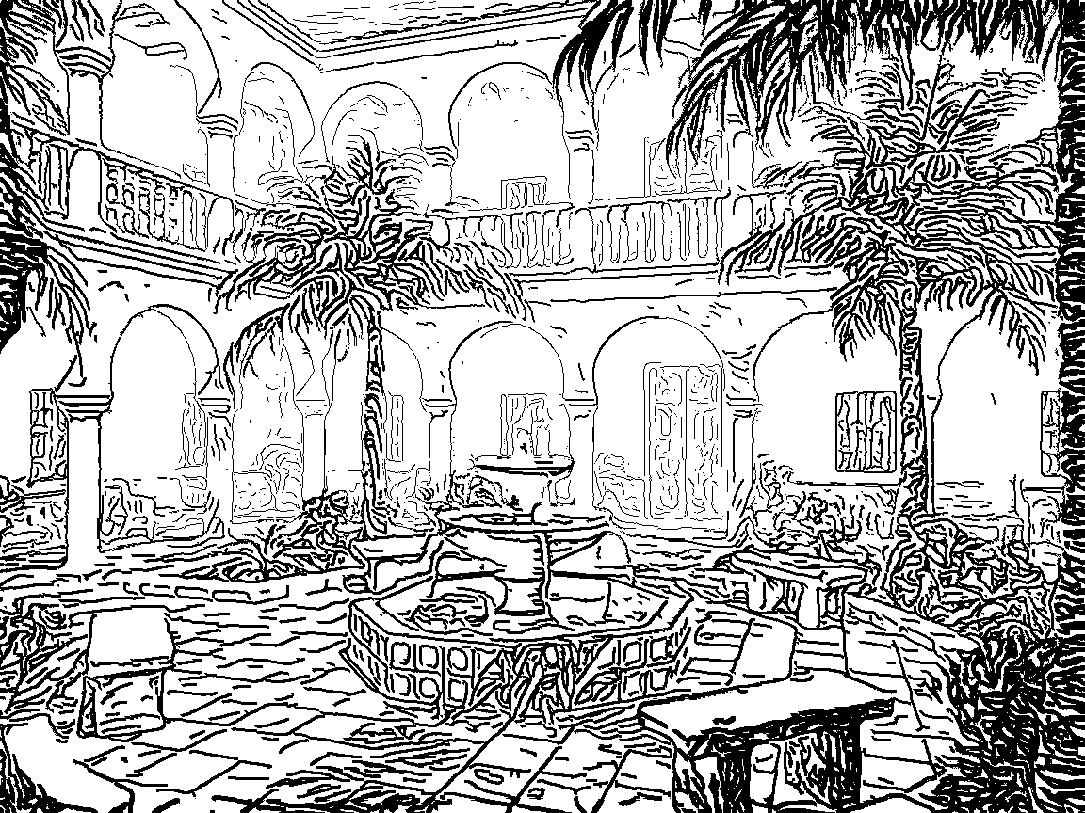
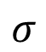
Overview
Input Depth
$$σ$$
Smooth Radius
Noise Suppression
Line
Parameters
Input Color
Gaussian Smoothing
Adaptive Edge Tangent Flow
Flow-based
DoG
Line Drawing

Slide 9
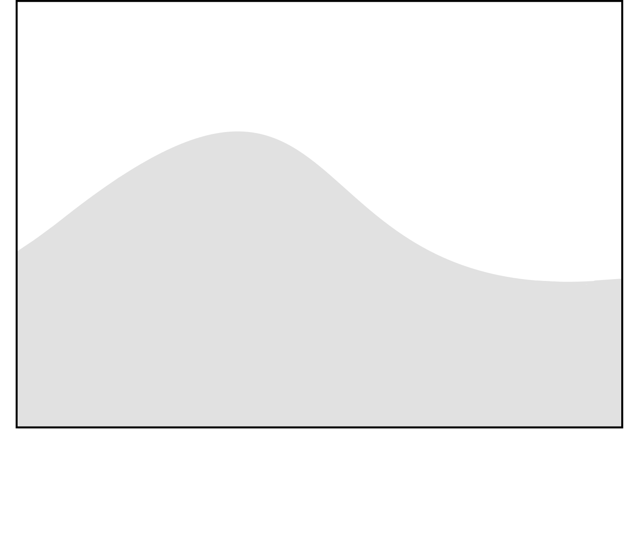
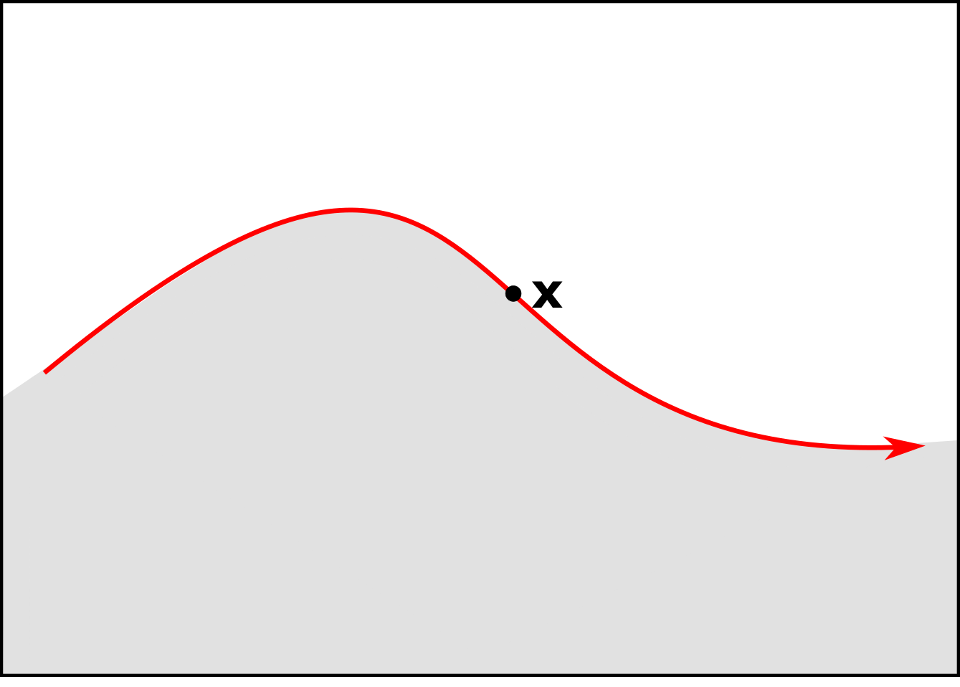
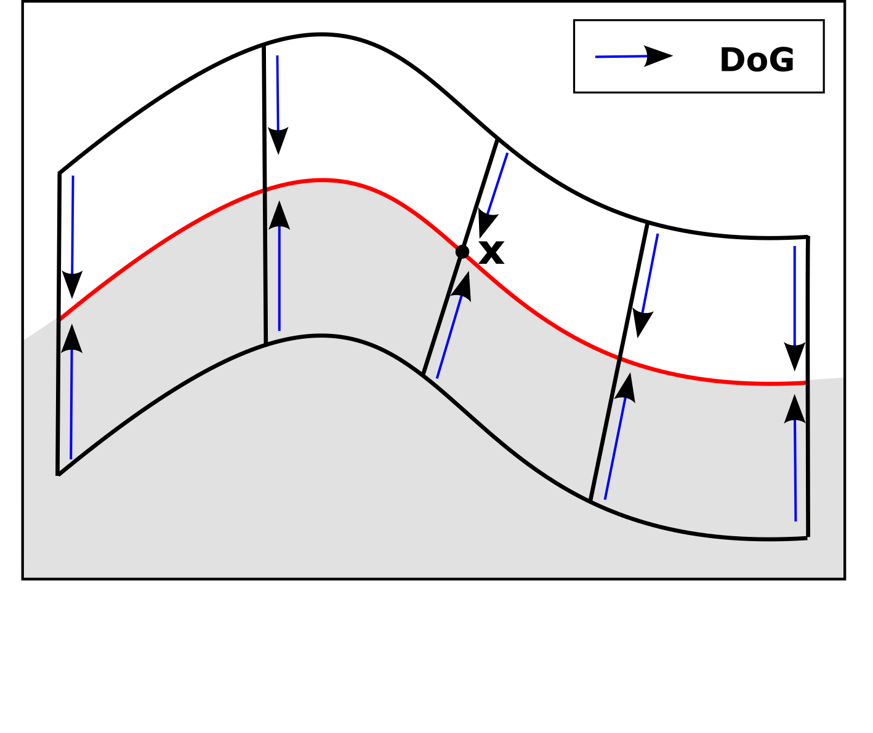
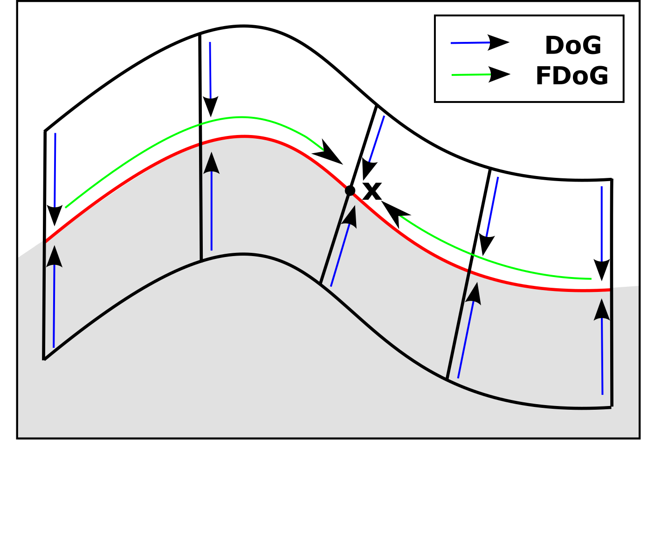
Flow-based Difference-of-Gaussians
Algorithm from [Kang et al. 2007]:
Input
(1)
(2)
(3)
Edge tangent flow (ETF)
Difference-of-Gaussians
Gaussian weighting along flow (FDoG)

Slide 10
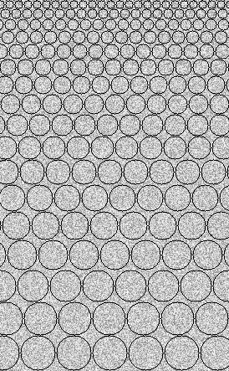
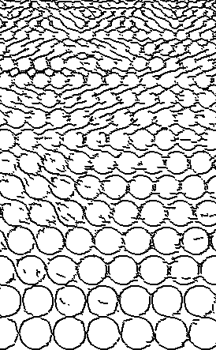
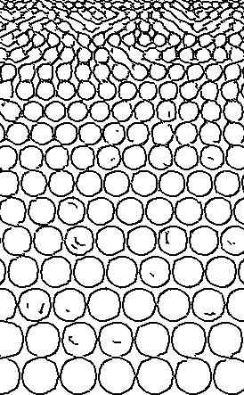
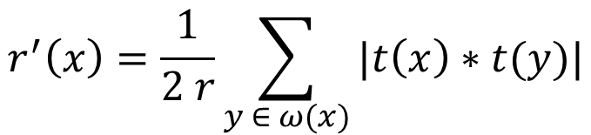
Adaptive Edge Tangent Flow
Extension to ETF construction:
Input
Original
Ours
$$r^{′}\left(x\right)=\frac{1}{2 r}\sum_{y ∈ ω(x)}{|t\left(x\right)∗t(y)|}$$
Average angular deviation

Slide 11
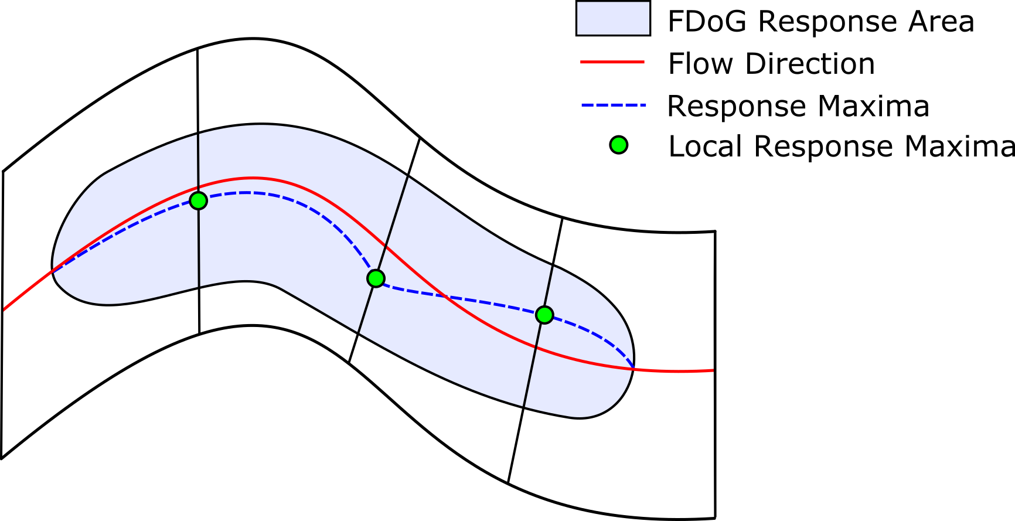
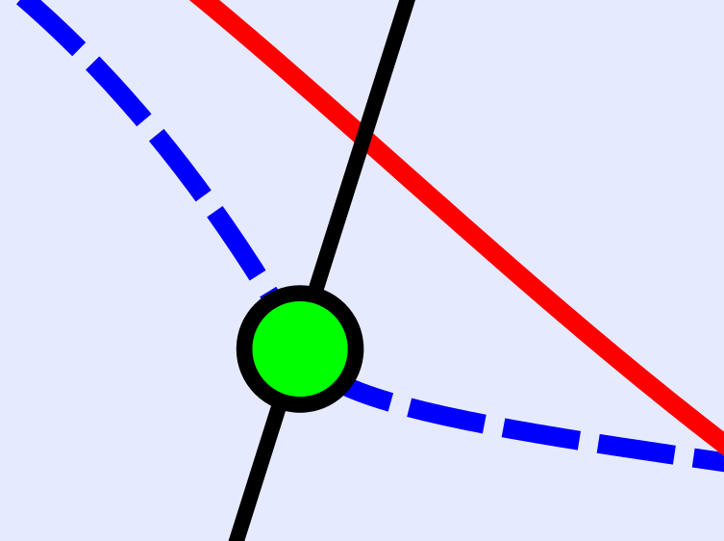
Flow-based Difference-of-Gaussians
Filter response forms an area:
Gradient ascend orthogonal to ETF for finding maximum response.

Slide 12
Line Drawing
Input Depth
Noise Suppression
Distance to Maximum
Details
Line Width

Slide 13
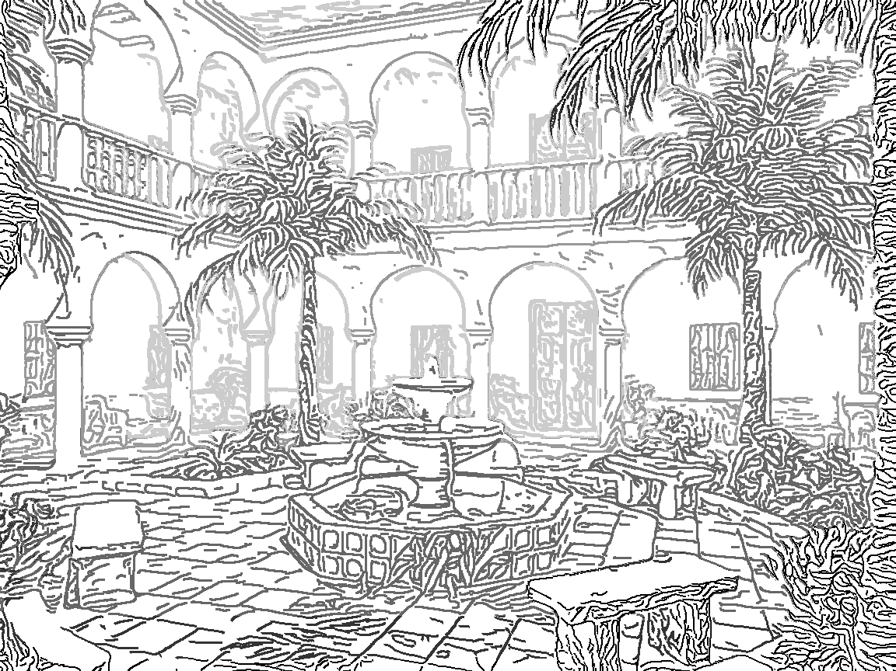
Line Drawing Styles
Style 1
Style 2
Line Parameters | Thick lines in close regions.
Reasoning | Focus user attention to close objects.
Line Parameters | Thick lines in close regions. | Thin line in close regions; Thick and faded out at the back.
Reasoning | Focus user attention to close objects. | Details in front. Analogue to painterly rendering.

Slide 14
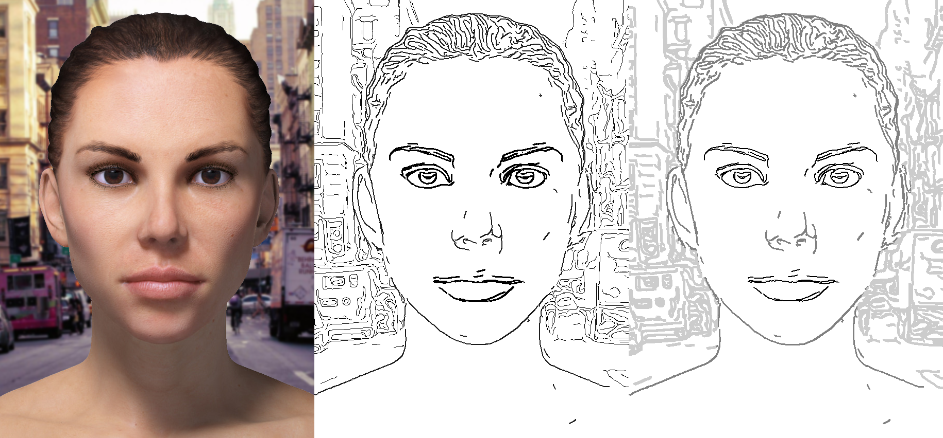
Line Drawing Styles - Applications
Importance map (inst. of depth) for highlighting.
Focus on eyes and mouth regions with our line drawing styles.

Slide 15

Line Drawing Styles - Future Work
Application: Individuals with Autism Spectrum Disorder
Focus on facial regions that convey emotions
Abstract other details of the face

Slide 16
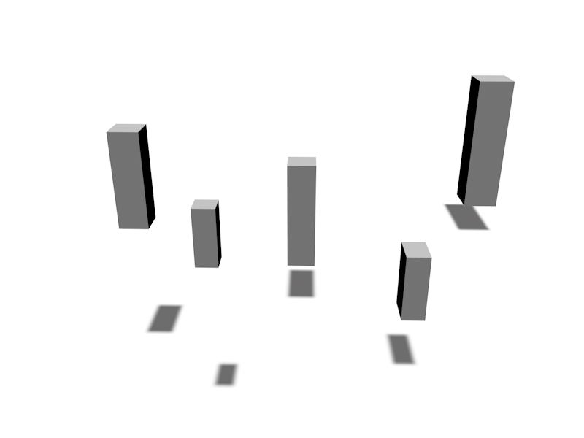
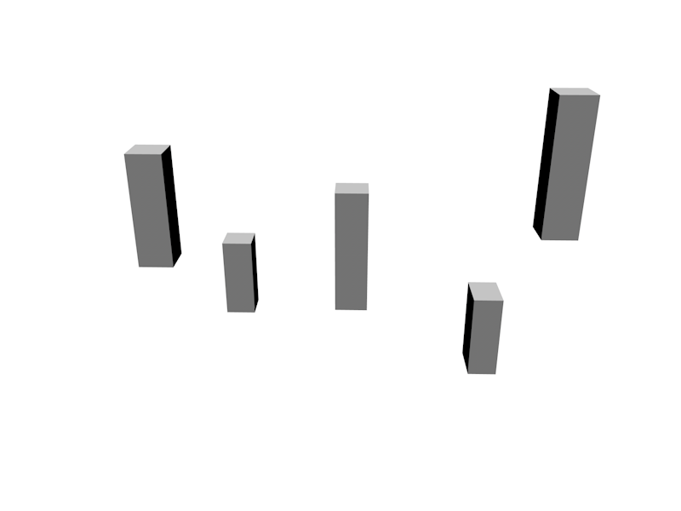
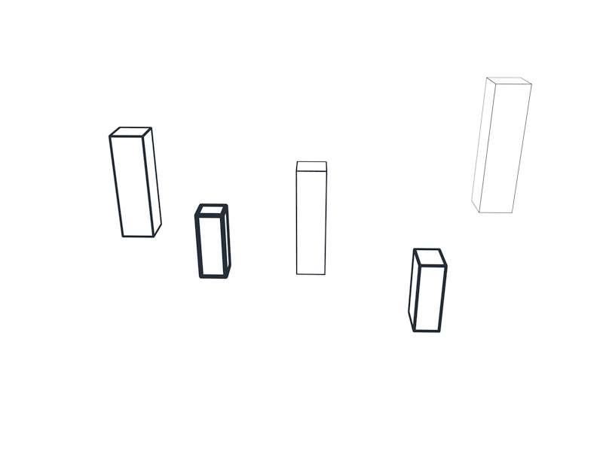
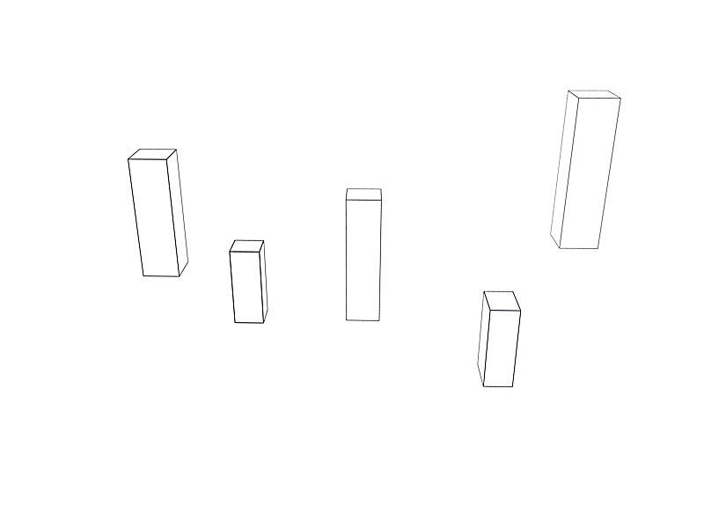
User study
Claim | Our line drawings improve depth perception.
Task | Order objects from front to back.
Results | Improved orderings (~0.88) vs. uniform lines (~0.55) Not as strong as shadows (~0.95)

Slide 17
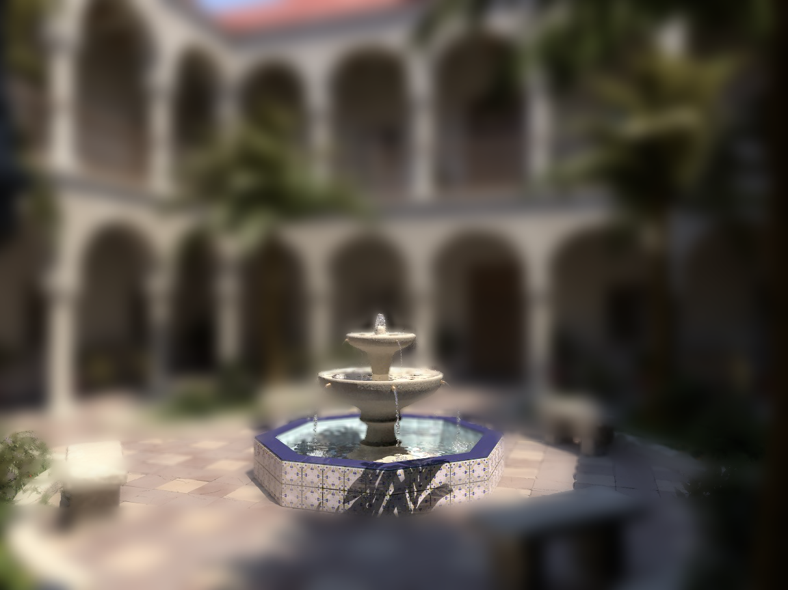
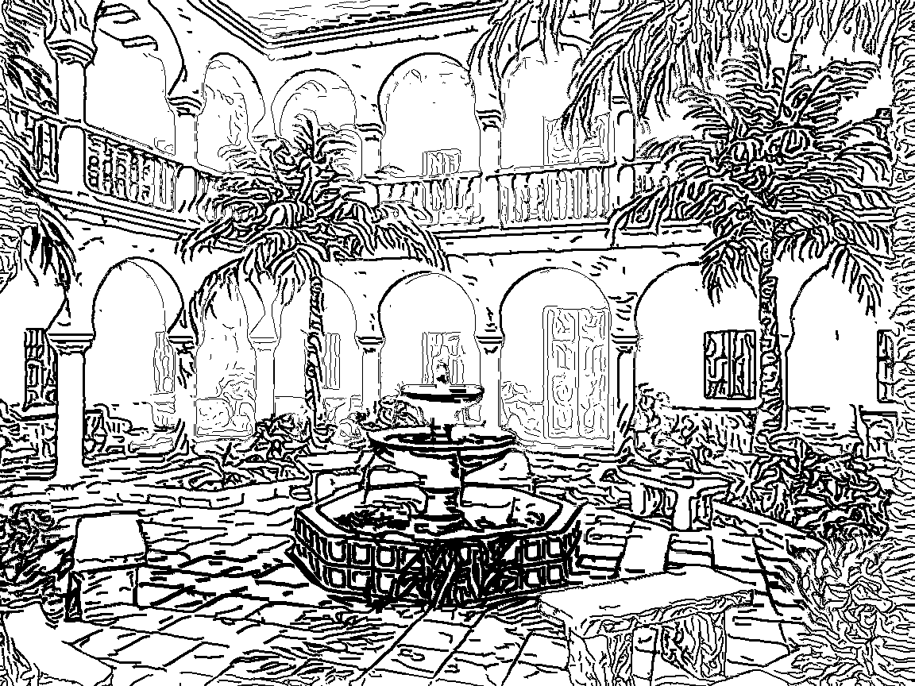
User study
Claim | Our line drawings allow to set the focus.
Task | Mark the area in focus.
Results | All subjects able to determine focal area with depth-of-field 76% of subjects in our line drawing

Slide 18
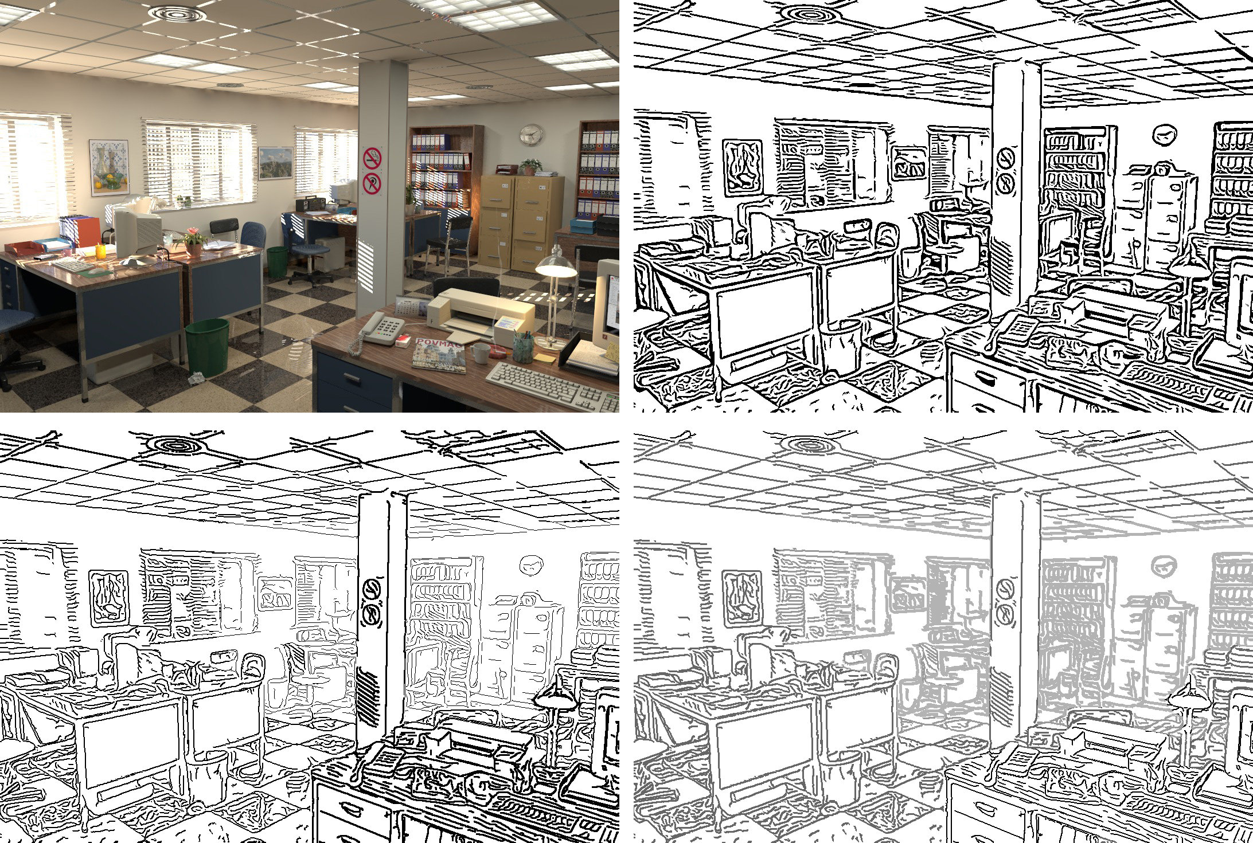
Results
Input
[Kang et al. 2007]
Ours (Style 1)
Ours (Style 2)

Slide 19
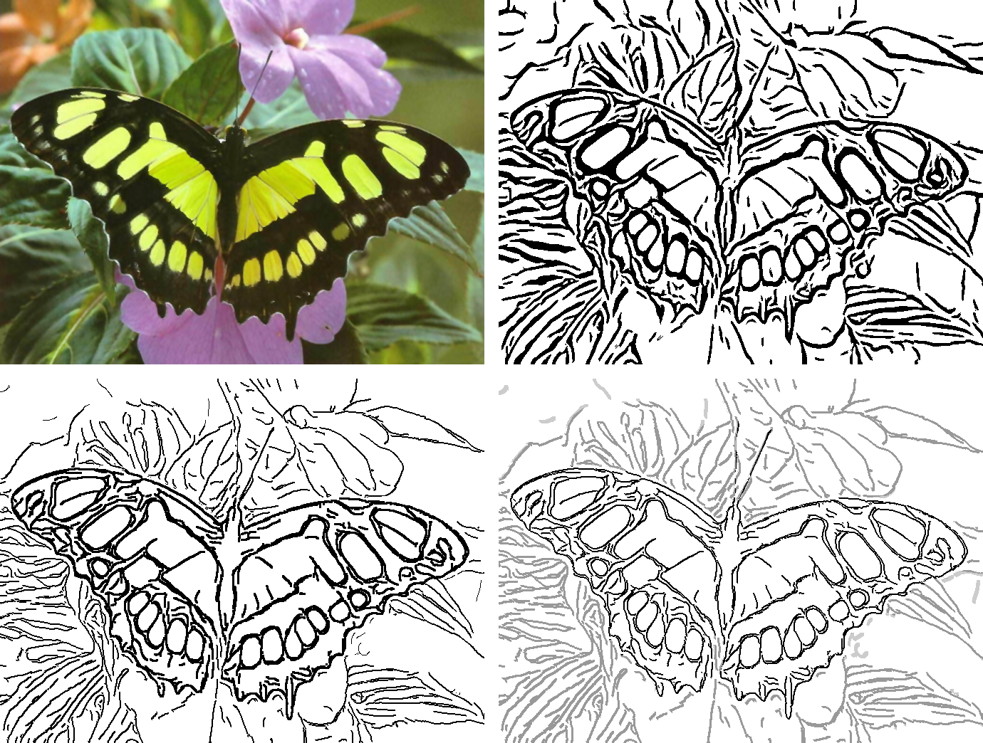
Results
Input
[Kang et al. 2007]
Ours (Style 1)
Ours (Style 2)

Slide 20
Limitations
ETF vector-based representation: Problems as described in [Zhang et al. 2007]
Parameters (e.g. kernel size) scale dependent
Coherence limited

Slide 21
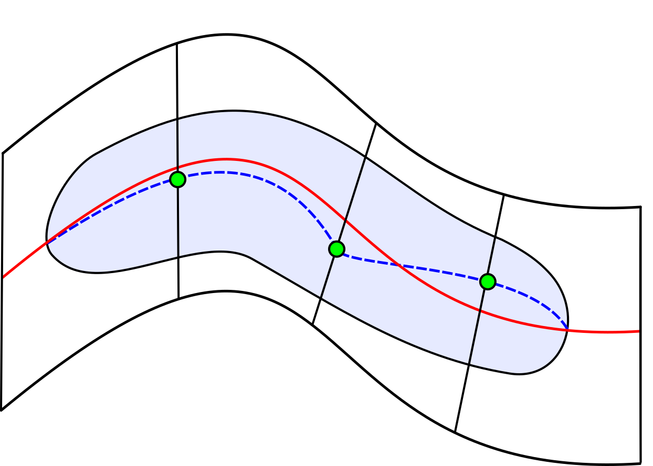
Conclusion
Improved Edge Tangent Flow construction method
Flow-based morphological filter
Two line drawing styles for better depth perception and object differentiation

Slide 22
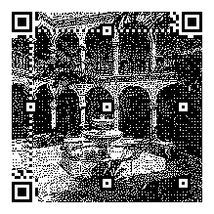
Thank you!
Contact:
marc.spicker@uni-konstanz.de

